Slide 1
MYELOID NEOPLASMS
Dr. Bindhusaran M.D. (Hom.)
Assistant Professor
Department of Pathology & Microbiology

Slide 2
MYELOID NEOPLASMS
myeloid neoplasms has following 5 groups
I. Myeloproliferative diseases II. Myelodysplastic/myeloproliferative diseases III. Myelodysplastic syndrome (MDS) IV. Acute myeloid leukaemia (AML) V. Acute biphenotypic leukaemia

Slide 3
MYELOPROLIFERATIVE DISEASE
The myeloproliferative disorders are a group of neoplastic proliferation of multipotent haematopoietic stem cells. Besides their common stem cell origin, these disorders are closely related
Te WHO classifcation of myeloproliferative disorders includes 7 types

Slide 4
I. MYELOPROLIFERATIVE DISEASES
1. Chronic myeloid leukaemia (CML), {Ph chromosome t(9;22) (q34;11), BCR/ABL-positive}
2. Chronic neutrophilic leukaemia
3. Chronic eosinophilic leukaemia/ hypereosinophilic syndrome
4. Chronic idiopathic myelofbrosis
5. Polycythaemia vera (PV)
6. Essential thrombocythaemia (ET)
7. Chronic myeloproliferative disease, unclassifable

Slide 5
CHRONIC MYELOID LEUKEMIA
DEFINITION (WHO):
It is established by identification of the clone of haematopoietic stem cell that possesses the balanced reciprocal translocation between chromosomes 9 and 22, forming Philadelphia chromosome.
The t (9;22) .The fusion product so formed is termed “Philadelphia chromosome t (9;22), BCR/ ABL” which should be positive for making the diagnosis of CML.

Slide 6
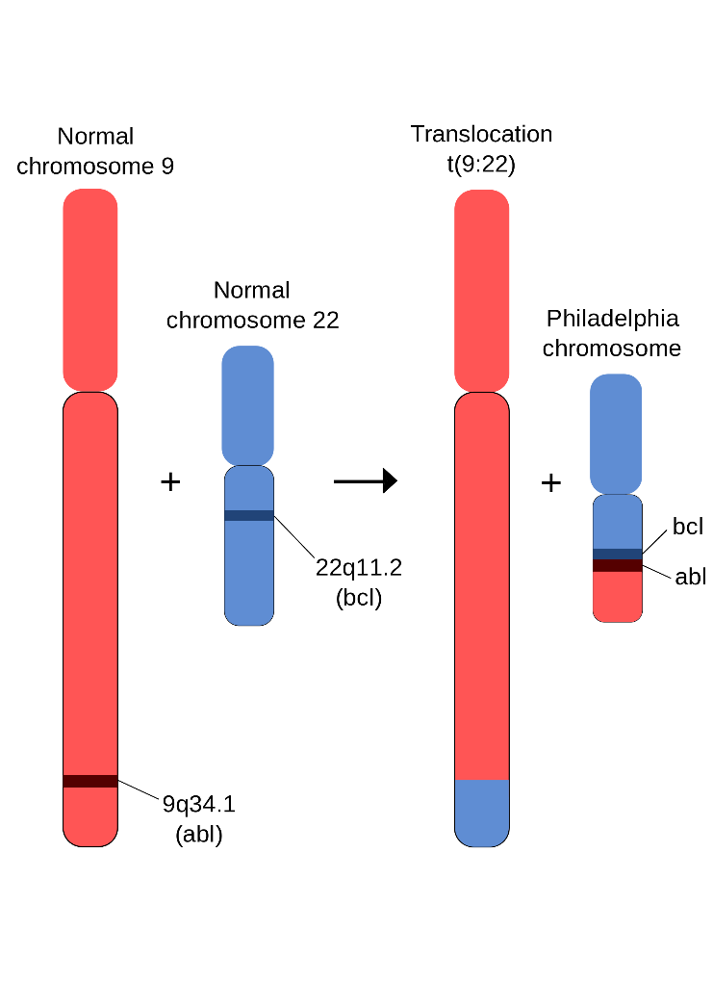
philadelphia chromosome

Slide 7
PATHOPHYSIOLOGY:
BCR fusion product brings about following functional changes:
(1) ABL protein is activated to function as a tyrosine kinase enzyme that in turn activates other kinases which inhibit apoptosis.
(2) Ability of ABL to act as DNA- binding protein is altered.
(3) Binding of ABL to actin microfilaments of the cytoskeleton is increased.

Slide 8
PATHOPHYSIOLOGY:
Exact mechanism of progression of CML to the blastic phase is unclear but following mechanisms may be involved:
(1) Structural alterations in tumour suppressor p53 gene.
(2) Structural alteration in tumour suppressor RB gene.
(3) Alterations in RAS oncogene.
(4) Alterations in MYC oncogene.
(5) Release of cytokine IL- 1BETA.
(6) Fuctional inactivation of tumour suppressor protein, phosphatase A2.

Slide 9
CLINICAL FEATURES:
The onset is generally insidious. Both sexes are equally affected.
Common presenting manifestations are:
Anaemia
Hypermetabolism- weight loss, lassitude, anorexia, night sweats.
Spleenomegaly- always present, frequently massive.
Bleeding tendencies- epistaxis, menorrhagia, haematomas.
Less common features – gout, visual disturbance
Juvenile CML- associated with lymphnode enlargement.

Slide 10
LABORATORY FINDINGS:
I. BLOOD PICTURE:
1. Anaemia- moderate degree , normocytic normochromic type , occasional normoblast present.
2. WBC – Leucocytosis (appr 200,000/ µl or more at the time of presentation). Consist of 3 phases: (a) chronic phase of CML – myeloblasts and basophil below 10%
(b) accelerated- myeloblasts and basophil 10 – 20 %
(c) blastic phase - myeloblasts and basophil > 20 %
3. Platelets- raised in half of the cases.

Slide 11
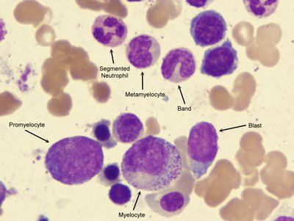

Slide 12
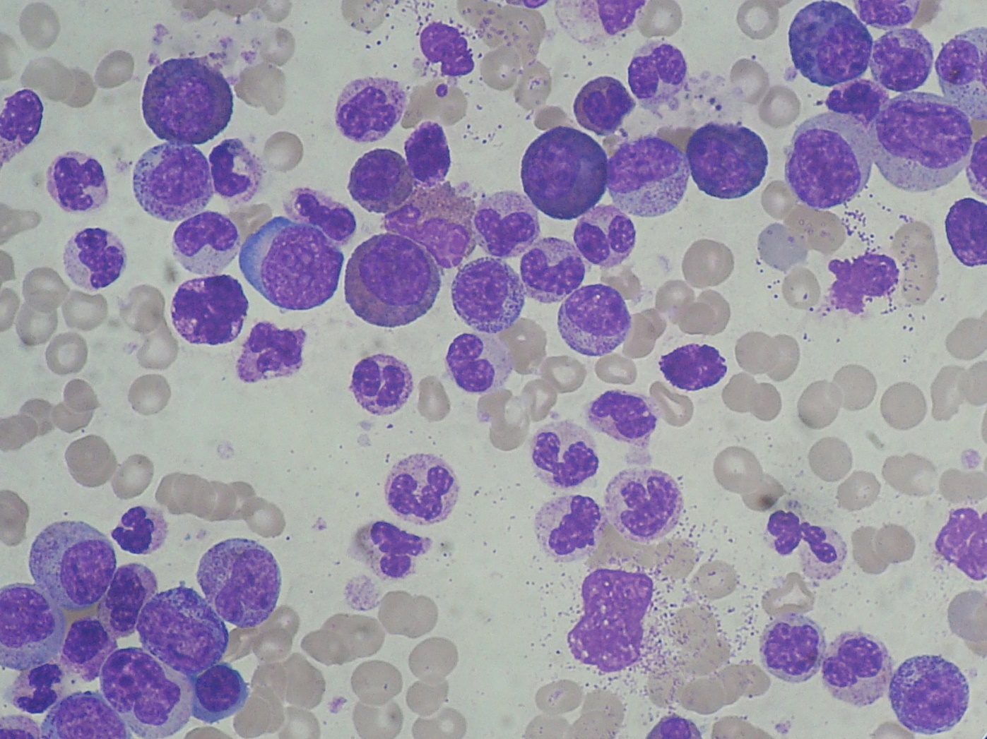

Slide 13
II. BONE MARROW EXAMINATION:
1.Cellularity- hypercellularity with total or partial replacement of fat spaces by proliferating myeloid cells.
2. Myeloid cells- they predominate in the bone marrow with increased myeloid- erythroid ratio.
3. Erythropoiesis- normoblastic but there is reduction in erythropoietic cells.
4. Megakaryocytes- smaller in size than normal.
5. Cytogenetics- show Philadelphia chromosome

Slide 14
III CYTOCHEMISTRY:
Neutrophil alkaline phosphatase is reduced
IV. Other findings
Elevated serum uric acid
Elevated serum B12

Slide 15
POLYCYTHEMIA VERA
It is clonal disorder characterized by increased production of all myeloid elements result in pancytosis

Slide 16
pathogenesis
tyrosin

